Slide 1
Modeling and Valuation of Pumped Storage Hydropower Resources
FERC Technical Conference
Majid Heidarifar, EPRI
Nikita Singhal, EPRI
Aidan Tuohy, EPRI
Russ Philbrick, Polaris
Erik Ela, EPRI
Pablo Ruiz, NewGrid
June 23, 2021
This presentation is, in part, supported by the U.S. Department of Energy, Water Power Technologies Office under Award Number DE-EE0008783 Predicting Unique Market Pumped Storage Significance (PUMPSS)

Slide 2
Pumped Storage Hydro Power Resources
By far the largest storage resource in the current electric grid
Fast Ramping Capability
Energy and AS provision
Help in both shortage and surplus conditions (pumping and generation)
Traditional Design not as flexible
Discrete operating range: block loaded especially in pumping mode
Need commitment decisions
Can have big impact on congestion
Historically there has not been a need for optimization because of predictable charge/discharge times
Disclaimer: “This presentation was prepared as an account of work sponsored by an agency of the United States Government. Neither the United States Government nor any agency thereof, nor any of their employees, makes any warranty, express or implied, or assumes any legal liability or responsibility for the accuracy, completeness, or usefulness of any information, apparatus, product, or process disclosed, or represents that its use would not infringe privately owned rights. Reference herein to any specific commercial product, process, or service by trade name, trademark, manufacturer, or otherwise does not necessarily constitute or imply its endorsement, recommendation, or favoring by the United States Government or any agency thereof. The views and opinions of authors expressed herein do not necessarily state or reflect those of the United States Government or any agency thereof.”
Disclaimer: This presentation includes draft results that are subject to change.

Slide 3
State of the Art
PSH presently participates in majority of ISO products
Offer as separate pump/generator participants
PJM – Hydro optimizer, optimizes mode of operation to minimize cost and ensure SOC targets
FERC Order 841: ISO/ RTO design proposals implementation details
Order 841 Aspect | NYISO | PJM | SPP | ISO-NE | MISO | CAISO
Participation Model | Most entities have proposed two separate participation models: Continuous (e.g., batteries) and discontinuous (e.g., PSH) models Rationale: ESRs are continuously dispatchable; PSH resources have forbidden operating regions that need to be accounted for appropriately ESRs can participate in energy, AS, and capacity markets (wherever applicable) Rationale: Requirement from FERC Order 841
 | ESRs and ELRs; PSH cannot submit a charge and discharge offer in the same hour | ESRs; PSH plants can still use pumped hydro optimizer | MSRs; PSH plants cannot submit a charge and discharge offer in the same hour | CSFs and BSFs (for PSH) | ESRs (also supports PSH) | NGRs and PSH model
AS: Ancillary Service; BSF: Binary Storage Facility; CSF: Continuous Storage Facility; ELR: Energy Limited Resource; ESF: Energy Storage Facility; ESR: Electric Storage Resource; MSR: Market Storage Resource; NGR: Non-Generator Resource; PSH: Pumped Storage Hydro; SOC: State of Charge

Slide 4
Overall Project Objectives
Goal: Develop a framework and outline the parameters needed to analyze the energy and ancillary services pumped storage hydropower (PSH) provides to the electricity grid currently and how that value may change as the generation asset mix, especially as it relates to increased penetration of variable renewable energy (VRE), on the grid changes over time.
Demonstrate current state-of-the-art in modeling of PSH operation
Improve state-of-the-art modeling approaches to better capture value of provision of certain essential reliability services (e.g., ramping, regulation, etc.) coming from PSH
Examine the value of different PSH technologies/configurations (e.g., traditional site-specific design, variable speed) and C rate (MWh/MW ratio) to better understand which technologies and storage durations may provide the most value
Determine the optimal configuration of PSH technology (i.e., capabilities and C rate) that maximizes PSH economic and system resilience and reliability value given existing market structures at current and anticipated future VRE penetrations
Attain a Deeper Understanding of the Value of PSH

Slide 5
Modeling Approach

Slide 6
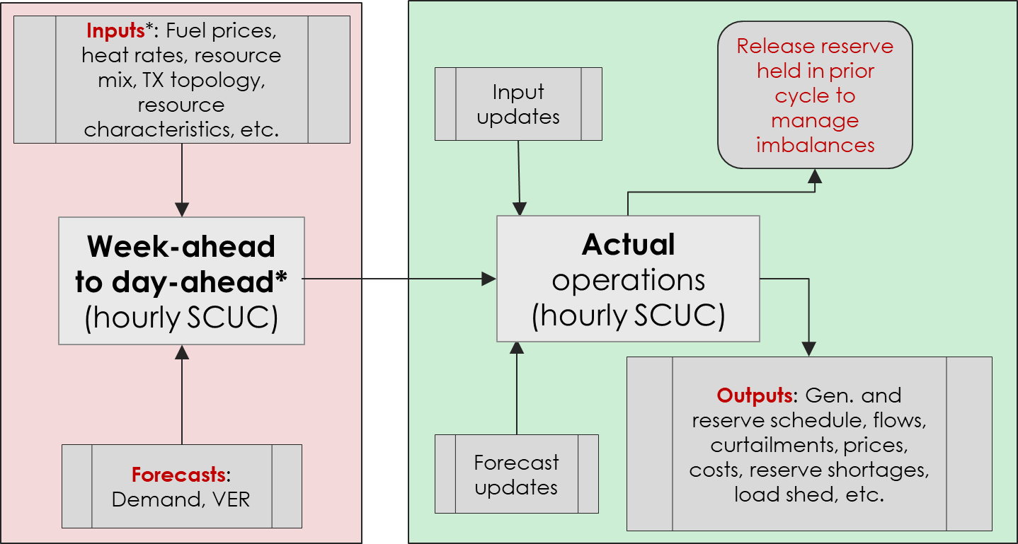
Southeast Utility Operations
The model is set up as illustrated in the figure, with a week-ahead run that is updated daily and simulated for every morning using updated information. Hourly ‘actuals’ will then be used for wind, solar, and load in the real-time run to ensure the impact of uncertainty is adequately captured in the model.
*DASCUC is run at 7AM on the current operating day due to less stressed conditions from midnight – 7am (ISOs/RTOs typically run their DAM at 11AM on the previous operating day or midnight), and run to end of 7 days out

Slide 7
PSH Facilities Modeling Approach in PSO
Enhanced Model
(multiple injectors)
(Ƞ1)
(Ƞ2)
(Ƞ3)
(Ƞ4)
L
G
L
G
recharge
+
L
Load (pump)
-
Generator
loss
G
Ƞ efficiency
Notes:
The pumps and turbines were then connected to the upper reservoir. Lower reservoir not modeled explicitly, assuming that its capacity and level would not limit or impact their operation.
Each PSH facility is modeled as four pumps and four turbines (i.e., eight injectors in total for each PSH). This separation allows for the enforcement of commitment constraints on individual turbine/pumps.
The total capacity mix by fuel type for the Southeast Utility system includes ~1,539 MW of conventional hydro resources, ~2,180 MW of PSH resources, ~3,085 MW of VREs (about 7.6 GW of VRE), and ~33,703 MW of conventional generation (steam, coal, combined cycle, combustion turbines). The physical and operating characteristics of the PSH resources were obtained and represented within the PCM in an accurate manner. The EPRI team has tested and validated the newly introduced Water Resources (WR) library in PSO in the past year. Note that the WR library was introduced to model PSH resources more accurately.

Slide 8
Southeast Utility: PSH Facilities Modeling Approach
PSH 1
PSH 2
Upper reservoir: 25,000 MWh
SSOC = TSOC = 12,500 MWh
Roundtrip efficiency: 80%
PSH 1 modeled as four pumps and four turbines (i.e., eight injectors in total)
Turbines: 250 – 350 MW
Pumps (block-loaded): Off (0 MW) and On (308 MW)
Pumps and turbines not allowed to operate simultaneously
Upper reservoir: 20,000 MWh
SSOC = TSOC = 10,000 MWh
Roundtrip efficiency: 80%
PSH 2 modeled as four pumps and four turbines (i.e., eight injectors in total)
Turbines: 170 – 195 MW
Pumps (block-loaded): Off (0 MW) and On (205 MW)
Simultaneous pumping and generation allowed, but restricted to specific combinations of pumps and turbines
Upper reservoir
Initial storage levels in day-ahead were adjusted using the real-time cycle’s (i.e., the last cycle’s) results
pipe
G
G
G
G
L
L
L
L
river
Lower reservoir
Disclaimer: Assumed specifications in the model.
SSOC: Start State of Charge; TSOC: Target State of Charge;
Notes:
The pumps and turbines were then connected to the upper reservoir. Lower reservoir not modeled explicitly, assuming that its capacity and level would not limit or impact their operation.
Each PSH facility is modeled as four pumps and four turbines (i.e., eight injectors in total for each PSH). This separation allows for the enforcement of commitment constraints on individual turbine/pumps.
The total capacity mix by fuel type for the Southeast Utility system includes ~1,539 MW of conventional hydro resources, ~2,180 MW of PSH resources, ~3,085 MW of VREs (about 7.6 GW of VRE), and ~33,703 MW of conventional generation (steam, coal, combined cycle, combustion turbines). The physical and operating characteristics of the PSH resources were obtained and represented within the PCM in an accurate manner. The EPRI team has tested and validated the newly introduced Water Resources (WR) library in PSO in the past year. Note that the WR library was introduced to model PSH resources more accurately.

Slide 9
Southeast Utility Operations: Scheduling Process
Day-Ahead
Includes 6-day look-ahead
Forecast CD
Forecast 1D
Forecast 2D
Forecast 3D
Forecast 4D
Forecast 5D
Forecast 6D
Jan. 4
Jan. 5
Jan. 6
Jan. 7
Jan. 8
Jan. 9
Jan. 10
End of
Horizon
Cluster 1
Actuals
Real-Time
Includes 6-hour look-ahead
Jan. 4
End of
Horizon
Rolling Horizon
Forecast CD
Forecast 1D
Forecast 2D
Forecast 3D
Forecast 4D
Forecast 5D
Forecast 6D
Day-Ahead
Jan. 5
Jan. 6
Jan. 7
Jan. 8
Jan. 9
Jan. 10
Jan. 11
Cluster 2
Actuals
Real-Time
Jan. 5

Slide 10
Proposed Case Studies
Study Region
Current Mix
Moderate VRE Mix
High VRE Mix
Operational Sensitivities
Storage SOC
Technology Sensitivities
Operational Sensitivties
AS Req*
Provision of AS
Technology Sensitvities
C-Rate*
VSG
Operational Sensitivities
Technology Sensitivities
Storage SOC
AS Req*
RT Correction
Provision of AS
C-Rate*
VSG
Resource Sensitivities
Electrification Case
Additional Retirement*
Fuel price*
Commitment Decisions
VSG
Simultaneous Pump/Gen
C-Rate*
Notes:
Base case includes about 3 GW of VRE, moderate case about 7.6 GW of VRE and high case about 20 GW of VRE. 3 GW of VRE corresponds to about 8.18% of instantaneous peak demand and about 6.88% of installed generation capacity. 7.6 GW of VRE corresponds to about 20.73% of instantaneous peak demand (in MW) with no load growth and about 15.77% of installed generation capacity. There is no wind in the Southeast Utility. 20 GW of VRE corresponds to about 54.54% of instantaneous peak demand (in MW) with no load growth and about 33% of installed generation capacity.
Adjustable Speed Generator sensitivity (e.g., eliminate the minimum pumping and generation constraints): Have soft agreement from GE to provide data.
Storage duration sensitivity (e.g., purposely add a few days with renewables being unavailable and observe the benefits of longer storage duration)
Reservoir value management sensitivity in the Southeast Utility. This is an operational sensitivity. The Southeast Utility, being a vertically integrated utility, owns the asset and so doesn’t have bidding strategies. Instead, there is the option to manage the level of water in the reservoir at the end of the operating week/day or real-time operating horizon in addition to its value. Therefore, the target state of charge/reservoir level (and potentially the opportunity costs to deviate from this target) will be varied in this scenario for the different VRE levels.

Slide 11
Modeling Results

Slide 12
System Characteristics
 | Current VRE Mix | Medium VRE Mix
Installed Capacity (GW) | 40.6 | 46.5
Peak RT Load (GW) | 33.1 | 37.8

Slide 13
Modeling Results: Sensitivity Analysis (Current VRE Mix)
Five Sensitivity Analysis Cases
Case 1: Base Case
Nomogram constraints to prevent simultaneous gen. and pumping
Limited Dispatchability Range
Adjustment of DA SOC based on latest RT information
PSH recommitment in RT
Case 2: No PSH nomogram constraint
Case 3: Increased Dispatchability Range (50%)
Case 4: No Adjustment of DA SOC
Case 5: PSH Commitment fixed in DA

Slide 14
Modeling Results: Sensitivity Analysis (Current VRE Mix)
Period of study: July 1st – 31st, 2019
Disclaimer: Assumed test case. Results may not reflect exact operations.
 | Total RT Cost ($MM) | % Cost Change
Case 1: Base Case* | 249.7 | -
Case 2: Simultaneous gen/pump allowed | 249.6 | -0.06%
Case 3: Variable Speed Technology (50%) | 248.8 | -0.36%
Case 4: No Adjustment of DA SOC | 250.3 | +0.21%
Case 5: PSH Commitment Fixed in DA | 251.6 | +0.73%
* Disallows Simultaneous gen/pump is not allowed, Fixed Speed Technology, Adjusts DA SOC based on RT telemetry, Allows PSH recommitment in RT

Slide 15
Modeling Results: Total Real-time Energy Cost
Period of study: July 1st – 31st, 2019
Disclaimer: Assumed test case. Results may not reflect exact operations.
 | Current VRE Mix |  | Medium VRE Mix
 | With PSH | Without PSH | With PSH | Without PSH
RT Cost ($MM) | 249.7 | 256.5 | 205.6 | 228.8
% Cost Increase | - | 2.7% | - | 11.3%
PSH reduces the total energy production costs by 2.7% (11.3%) in current (medium) solar penetration scenarios

Slide 16
Generation Dispatch Profile in RT (Current VRE Mix)
w/ PSH
No PSH

Slide 17
Cleared RT Reserve Profile (Current Penetration)
Notes:
ADD Figures from Russ’s presentation

Slide 18
Cycling of Thermal Generators (Current VRE Mix)
Increased cycling of Combined Cycle and Combustion Turbine generators in absence of PSH resources
Number of Startups per Technology Type
 | Coal | Ngas (CC) | Ngas (CT) | Oil (CT) | PSH (Gen) | PSH (Pump)
w/ PSH | 13 | 33 | 658 | 0 | 229 | 249
w/o PSH | 18 | 42 | 1038 | 3 | 0 | 0
Startup Cost per Technology Type
 | Coal | Ngas (CC) | Ngas (CT) | Oil (CT) | PSH (Gen) | PSH (Pump) | Total
w/ PSH | 0.46 | 0.36 | 2.49 | 0.00 | 0.34 | 0.00 | 3.64
w/o PSH | 0.51 | 0.46 | 3.75 | 0.09 | 0.00 | 0.00 | 4.81

Slide 19
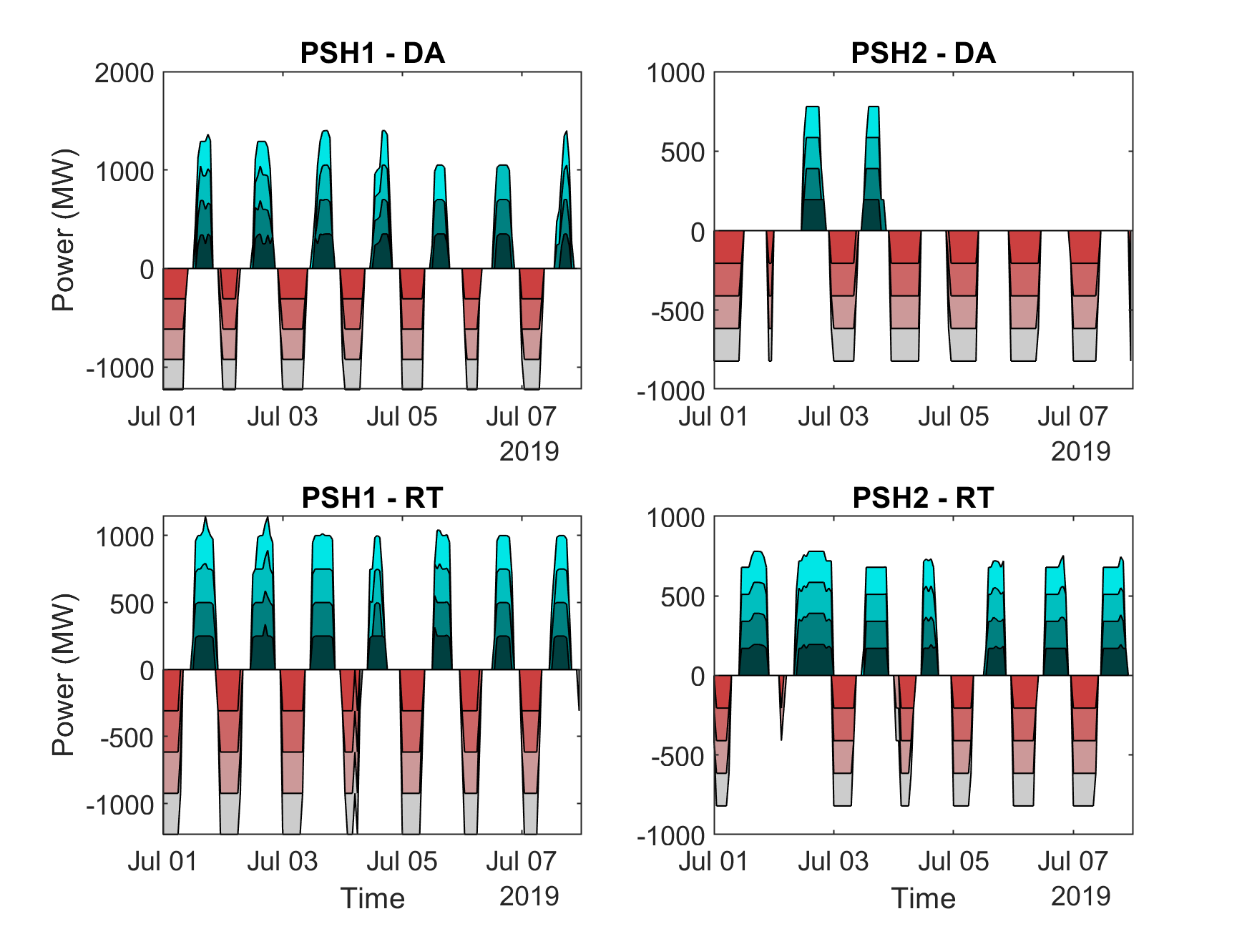
Modeling Results: DA and RT PSH Schedule (Current VRE Mix)
Period of study: July 1st – 31st, 2019
Disclaimer: Assumed test case. Results may not reflect exact operations.
PSH1:
Reservoir: 25,000 MWh
Roundtrip efficiency: 80%
Four pumps and four generators
Generators: 250 – 350 MW
Pumps (block-loaded): Off (0 MW) and On (308 MW)
Pumps and turbines not allowed to operate simultaneously
PSH2:
Reservoir: 20,000 MWh
Roundtrip efficiency: 80%
Four pumps and four generators
Generators: 170 – 195 MW
Pumps (block-loaded): Off (0 MW) and On (205 MW)
Under certain combinations, simultaneous Pump and generation is allowed

Slide 20
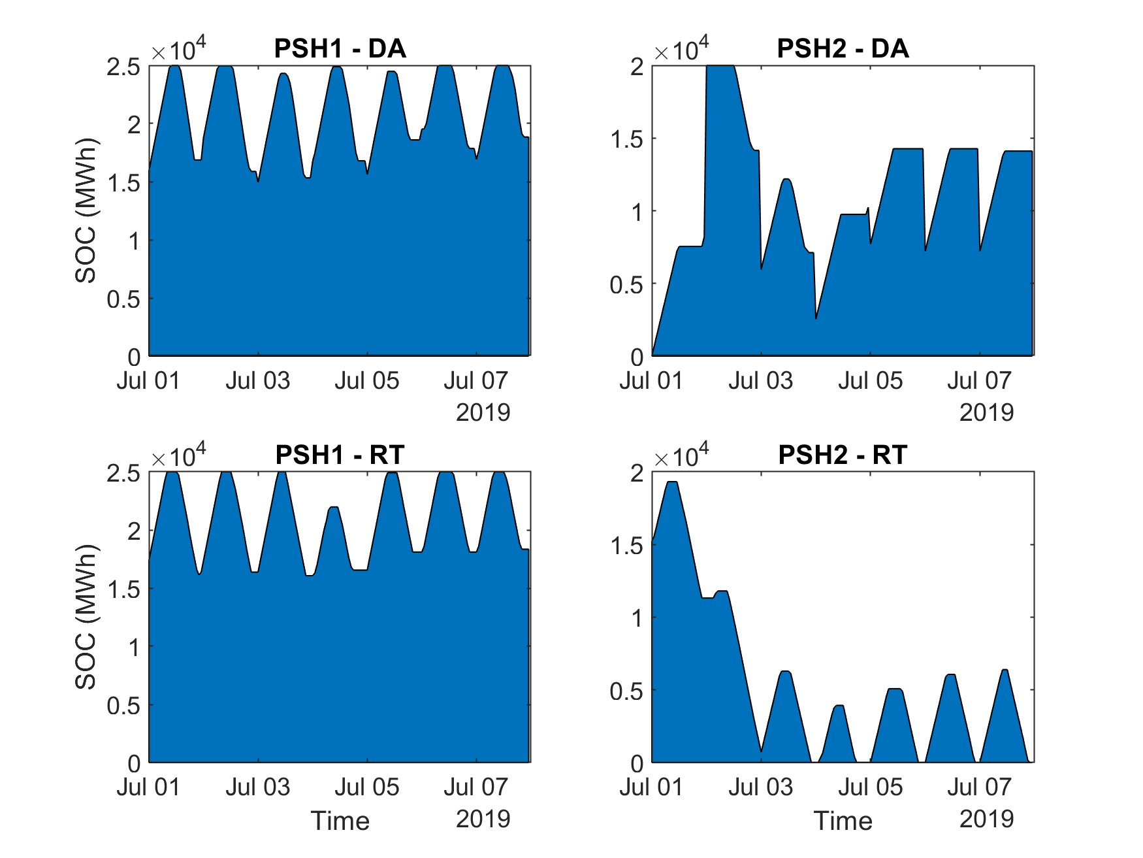
Modeling Results: DA and RT PSH SOC (Current VRE Mix)
Period of study: July 1st – 31st, 2019
Disclaimer: Assumed test case. Results may not reflect exact operations.

Slide 21
Key Observations
Total energy production costs increase in absence of PSH resources (by ~2.7% in current penetration, and 11.3% in future medium penetration)
PSH reduces cycling of thermal generators (CCs and CTs)
PSH contributes considerably to RT contingency reserve, and regulation up and down reserves
Allowing simultaneous generation and pumping may not result in considerable cost savings for an uncongested system
Block loading has an increased likelihood of resulting in increased operating cost
Variable Speed Technology enhances flexible operation
There is a need to better understand how adjusting the initial SOC in the DA based on latest RT info can impact the market solution
Example: ERCOT

Slide 22
Other Considerations: management of water quantities
Cascading systems with time requirements for flow between reservoirs
Constraints on river flows
Impact of reservoir head and tailwater losses
inflow
PSH reservoir
(integrated)
L
G
loss
inflow
L
G
G
G
G
river
pipe
loss
water supply
L
G
river
cooling

Slide 23
Majid Heidarifar, mheidarifar@epri.com
Nikita Singhal
Aidan Tuohy
Russ Philbrick
Erik Ela
Pablo Ruiz

Slide 24
Order 841: State of Charge Management
Required ISO to allow self-management of SOC by ESR
Required “consideration” of SOC related parameters through bidding, telemetry, or otherwise (e.g., SOC limits, round-trip efficiency)
[1] Electric Storage Participation in Markets Operated by Regional Transmission Organizations and Independent System Operators, FERC Order 841, Final Rule, 162 FERC 61, 127 (February 15, 2018) (“Order No. 841”).

Slide 25
ISO/RTO Design Proposals: Implementation Details
Order 841 Aspect | NYISO | PJM | SPP | ISO-NE | MISO | CAISO
State of Charge Management | Only a few ISOs are offering both ISO-SOCM and Self-SOCM. Other ISOs are offering a hybrid SOCM-Lite option. ISO-SOCM: SOC is a variable in multi-interval optimization and the ISO ensures SOC feasibility. SOCM-Lite: SOC is a parameter in sequential optimization and the ISO ensures SOC feasibility. Rationale: Requirements from FERC Order 841; SOCM option is also impacted by the market clearing software design
 | ISO-SOCM (excludes desired ending SOC level) and Self-SOCM (does not ensure SOC feasibility, but ISO will align schedules with telemetered SOC in the RTM); NYISO can suspend ISO-SOCM and default to Self-SOCM; PSH plants – Self-SOCM; ESRs have the option to switch b/w SOCM modes within RTM, and b/w DAM and RTM | ESRs – SOCM-Lite (ensures SOC feasibility and accounts for SOC, and SOC limits in its sequential optimization); PSH plants – ISO-SOCM | SOCM-Lite (ensures SOC feasibility in sequential optimization); can submit max daily MWh limit | SOCM-Lite (includes two new telemetered points in RT, i.e., 15-minute and 1-hour available energy and available storage, to ensure SOC feasibility in sequential optimization); ESFs can submit max daily MWh charge and discharge limits in the DAM. No SOC-specific parameters in DAM. | SOCM-Lite (ensures SOC feasibility in sequential optimization); max daily MWh limit included only for PSH plants | ISO-SOCM (excludes desired ending SOC level) and Self-SOCM (does not ensure SOC feasibility); can submit daily min and max energy limits for DAM
AS: Ancillary Service; BSF: Binary Storage Facility; CSF: Continuous Storage Facility; DAM: Day-ahead Market; DR: Demand Response; ESF: Energy Storage Facility; ESR: Electric Storage Resource; MSR: Market Storage Resource; NGR: Non-Generator Resource; POI: Point of Interconnection; PSH: Pumped Storage Hydro; RTM: Real-time Market; SOC: State of Charge; SOCM: SOC Management

Slide 26
State of Charge Management: Options
Self-Schedule
ESR self-dispatches its output and is insensitive to price.
Self-SOC-Management
ESR provides an offer curve analogous to traditional resources.
ESRs can set offers to ensure desired and feasible SOC.
SOC-Management-Lite
ESR provides an offer curve.
ISO-SOC-Management
ESR may or may not provide an offer curve.
ISO ensures SOC feasibility and optimizes ESR schedules across time to minimize cost.
ISO does not schedule ESR if it would lead to infeasible SOC.
Schedules are not optimized across time to optimize ESR schedules.
ISO schedules without SOC consideration
Allowed by all ISOs/RTOs
CAISO, NYISO ESRs, NYISO PSH units
SPP, ISO-NE, MISO, PJM
CAISO, NYISO ESRs,
PJM PSH units
ISO Scheduling Responsibility / Theoretical Economic Efficiency and Reliability Benefits / Complexity
ESR Asset Owner Participation Responsibility and Flexibility / Computational Efficiency

